Slide 1

Hacking with React
http://www.hackingwithreact.com/
Notes:
Mitrais CDC React, delivered on 12/2/2016 by Havit Choirul Rovik

Slide 2


Hacking with React
SuperAgent
React Router
Jest
ESLint
Notes:
On the part 1 presentation, we already discussed about
SuperAgent : a small progressive client-side HTTP request library https://github.com/visionmedia/superagent
React Router : a complete routing library for React https://github.com/ReactTraining/react-router
Now, it’s time for the second part
Jest : a JavaScript testing framework https://facebook.github.io/jest/
ESLint : a pluggable linting utility for JavaScript and JSX http://eslint.org/

Slide 3


Jest
Jest is a JavaScript testing framework, used by Facebook to test all JavaScript code including React applications.
https://facebook.github.io/jest/
Notes:
Maybe some of you already familiar with nUnit, jUnit or Jasmine. It’s a kind of that, unit testing framework but for Javascript.
It was written to help test react apps, and is perfect for that purpose!
It makes writing tests as easy as speaking - you describe a unit of your code and expect it to do the correct thing.
Jest uses Jasmine under the hood, so if you ever get in touch with Jasmine before, you will be familiarized with the syntaxes on Jest.
References
https://jasmine.github.io/
http://academy.plot.ly/react/6-testing/

Slide 4



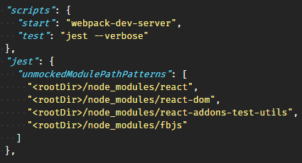
Configuration
mkdir __tests__
modify package.json
npm test
Notes:
That's two underscores, the word "tests", then two more underscores. Please name it exactly that otherwise your tests will not work.
The reason we had to name our test directory tests is because that's exactly what Jest looks for when it runs its test process: all JavaScript files in there are considered tests and will be executed.
So, we can put a test into that folder, and npm run test will automatically find it, run it, and tell us the results.
The --verbose indicates whether each individual test should be reported during the run. All errors will also still be shown on the bottom after execution.
Last, ensure the Jest is configured properly by running npm test.

Slide 5
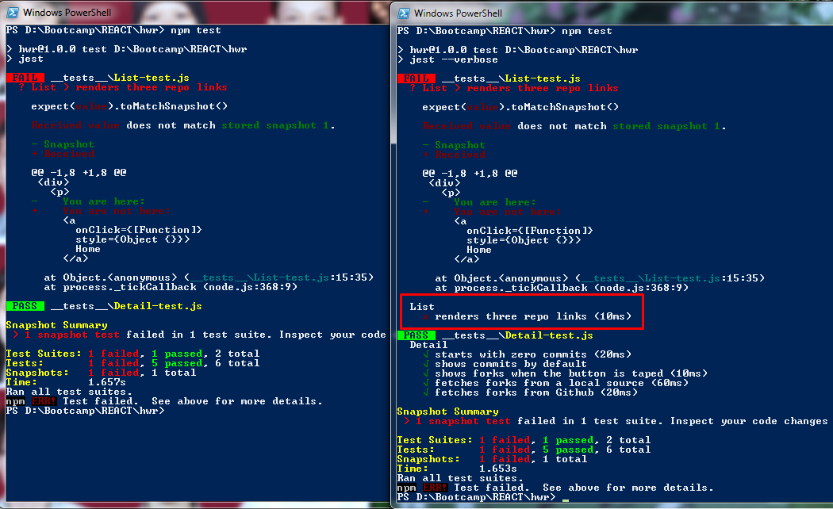
--verbose
Notes:
Just a quick comparison what verbose means. Left is Jest, right is Jest with verbose.
There are two test suites: List-test and Detail-test. Notice that verbose gives us more detail about the test.

Slide 6

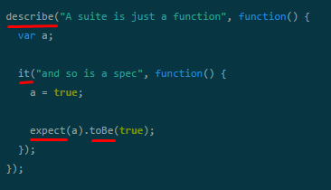
Beginner's explanation
Suite
Spec
Assertion
Matcher
Notes:
Before moving on too far, let’s see how the unit test that using Jasmine looks like.
describe(“A suite is just"... is what we call a suite. This is basically a component of your application; this could be a class or just a slew of functions. This suite is called “A suite is just a function"; it's English, not code.
Inside of that (technically inside of the anonymous function, nerd), you've got the it() function. This is called a spec. It's a JavaScript function that says what some piece of your program should do. It says it in plain English (“and so is a spec") and in code. For each suite, you can have many specs for the many tests you want to do.
When you're writing tests, you need to check that values are what you expect all the time. That's what you use expect for.
In this case, we're testing if variable a does indeed equal true. This check is called a matcher. There a bunch of them and you can also define your own if you please.
Reference:
https://jasmine.github.io/
http://evanhahn.com/how-do-i-jasmine/

Slide 7


Beginner's example
Notes:
Ok. Now let’s take a look on the real example.
Open Hacking with React on VS Code
Expand src – pages : the code we want to test
Expand __tests__ : folder for our test
Create new file on src
cd src
touch HelloWorld.js
Open HelloWorld.js, copy – paste following code:
function HelloWorld() {
return "Hello, world!";
}
export default HelloWorld;
Save
Delete forks.json, List-test.js, Detail-test.js, and the __snapshots__ folder. We don’t need them at the moment.
cd __tests__
rmdir .\__snapshots__
del *.*
Create new file on __tests__
touch HelloWorld-test.js
Open HelloWorld-test.js, copy – paste following code:
import helloWorld from '../src/HelloWorld';
describe("Hello world", function() {
it("says hello", function() {
expect(helloWorld()).toEqual("Hello, world!");
});
});
Save
Run npm test
Any question so far?
Reference: http://evanhahn.com/how-do-i-jasmine/

Slide 8




React + Jest
Snapshot
Testing?
toMatchSnapshot
react-test-renderer
Notes:
Another concept on React – Unit testing. Snapshot testing was introduced in Jest 14.0.
One of the big open questions was how to write React tests efficiently. There are plenty of tools such as ReactTestUtils and enzyme. Both of these tools are great and are actively being used. However engineers frequently spend more time writing a test than the component itself. How to make sure their components don't change unexpectedly?
It’s the answer. Together with the React team, Jest team created a new test renderer for React and added snapshot testing to Jest.
The idea is quite similar to the UI snapshot tests some of you may know: You take an image of your current app in a specified state and compare it to the previous image you have taken.
react-test-renderer : to capture snapshots with Jest's snapshot feature. It renders React components to pure JavaScript objects, without depending on the DOM or a native mobile environment. Essentially, this makes it easy to grab a snapshot of the "DOM tree" rendered by a React DOM or React Native component without using a browser
toMatchSnapshot() matcher : to ensures that a React component matches the most recent snapshot.
Source:
https://www.npmjs.com/package/react-test-renderer
https://facebook.github.io/jest/blog/2016/07/27/jest-14.html
https://facebook.github.io/jest/docs/tutorial-react.html#snapshot-testing
https://medium.com/@dschmidt1992/jest-snapshot-testing-3ef9fa1222bb

Slide 9
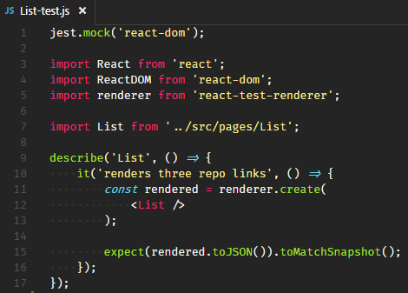
Jest: List-test.js
Notes:
jest.mock means that the module system should always return a mocked version of the specified module from require() or import,
(e.g. that it should never return the real module).
You’re already know, right? In simple, mocking is creating objects that mimic the behavior of real objects. In this case, react-dom will be explicitly mocked.
Let’s see how it works.
First, Undo List-test.js
npm test
The first time this test is run, Jest creates a snapshot file that looks like this: {open the List-test.js.snap file}.
Jest uses pretty-format to make snapshots human-readable during code review. On subsequent test runs Jest will simply compare the rendered output with the previous snapshot. If they match, the test will pass. If they don't match, either the implementation has changed and the snapshot needs to be updated with jest -u, or the test runner found a bug in your code that should be fixed.
npm test again, Jest doesn’t create the snapshot file anymore.
Now imagine this scenario: there is changes on the List.js file . Edit “You are here” to “You are not here”. Add new Link "/detail/jessica“.
npm test. It failed.
If the changes is expected, then we need to update the snapshot file: --updateSnapshot or npm test -- -u
Open changes comparer

Slide 10

React + Jest
Notes:
DOM Testing. Actually, DOM Testing using Enzyme or React's TestUtils was the proper way to test React components, before Snapshot Testing was introduced in Jest version 14.
To use it, you need to run: npm install --save-dev react-addons-test-utils
Reference:
https://facebook.github.io/jest/docs/tutorial-react.html#dom-testing
https://facebook.github.io/react/docs/test-utils.html
Original image from here: https://assets.toptal.io/uploads/blog/image/398/toptal-blog-image-1400205952695.png

Slide 11
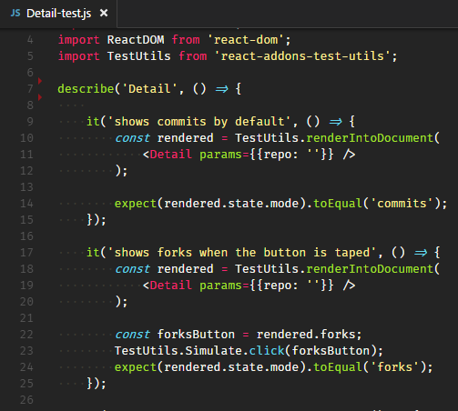
Jest: Detail-test.js
Notes:
Let’s examine the code.
jest.autoMockOff means we disable automatic mocking in the module loader. After this method is called, all require()s or import will return the real versions of each module (rather than a mocked version).
As you can see, here I import react-addons-test-utils instead of react-test-renderer . And in the spec you won’t see toMatchSnapshot since the TestUtil won’t produce snapshot file.
TestUtils.renderIntoDocument is used to render a component in a real, but detached element of the DOM. You will see this pattern every time when you test React component with the real rendering to DOM.
The second test for this component is to check that the component is set to render commits by default. If you remember, the GitHub Browser we made shows the commits for the first time. {Open Detail.js, Ctrl + \ to put it side by side}
See? The default mode is commits when the Detail component rendered. The second test is to test this behavior.
The third test, it’s similar to the previous but here we simulate a click to the forks button. {Scroll Detail.js to onClick={this.selectModes.forks}}
The TestUtils.Simulate.click() method is pretty self-explanatory: it simulates a click on something in our document, in this case a button.
Reference:
http://reactkungfu.com/2015/07/approaches-to-testing-react-components-an-overview/

Slide 12
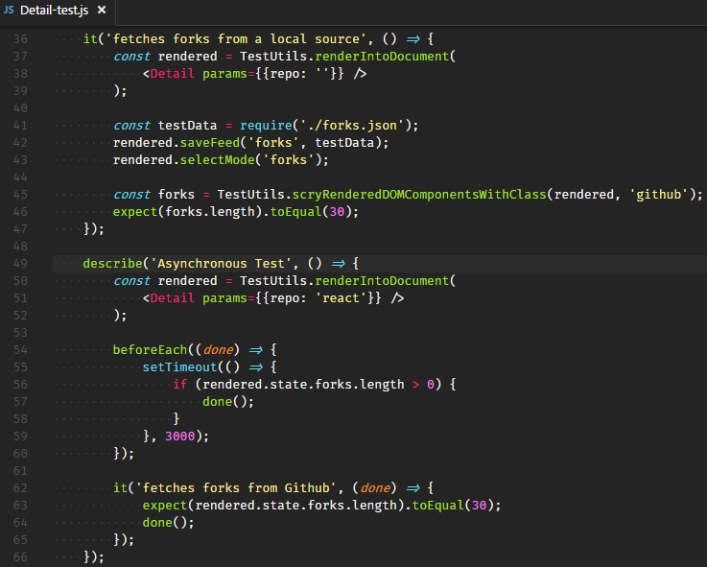
Jest: Detail-test.js
Notes:
Move to the 4th test, fetches forks from a local source.
Here, I introduce a dummy data, forks.json . {Scroll Detail.js, saveFeed(type, contents)}
So, instead of fetching data from Github.com, the test loads a local JSON file then inject it into Detail component. Using this approach, the test runs faster because there's no network delay, we can be sure of always getting good data, and it won't get rate limited by the GitHub API.
The scryRenderedDOMComponentsWithClass is a method from TestUtils to finds all DOM elements of components in the rendered tree that are DOM components with the class name matching ’github’. {Refer to <p key={index} className="github">}
Last test, you see something new here: calls to describe can be nested & beforeEach, which is used to test Asynchronous code. If you are following the tutorial from its site, hackingwithreact.com, you will notice there is different syntax. The original code is still using Jest with Jasmine1, here it’s using Jest with Jasmine2.
Jasmine 2.0 adds async support to the primitive beforeEach(), afterEach() and it() functions. The callback functions passed to these functions now can take an argument that indicates if the spec can or cannot run. Then, when it reaches the necessary conditions to run the test (whenever the async job is complete), it simply calls done().
The it() spec above will run only after the setTimeout() call, because done() is called there.
Reference:
https://facebook.github.io/react/docs/test-utils.html#scryrendereddomcomponentswithclass
http://stackoverflow.com/questions/20119324/jasmine-2-0-rc-waits-is-not-defined

Slide 13



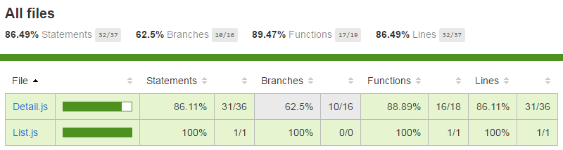
Code Coverage
Modify package.json
test: jest –coverage
Report
<rootDir>/coverage/lcov-report/index.html
Notes:
Maybe some of you already have experience with it, “the code coverage must be at least 80%” ☺
From Wikipedia, code coverage is a measure used to describe the degree to which the source code of a program is executed when a particular test suite runs.
And that is step to check code coverage within Jest. When we run the test again,
not only we will get the code coverage every time we test, but we’ll also get the report file at that location.
{Live Demo}
Modify package.json
Run npm test
Show the built in report / terminal
Expand coverage folder
Open lcov-report\index.html
Show the report in browser
Notice that List already have 100% but not Detail. Let’s see the Detail. See? There is hint , else path not taken. Let’s try to increase its code coverage.
Reference:
https://en.wikipedia.org/wiki/Code_coverage
http://adambac.com/testing-es6-apps-easily-with-jest/

Slide 14

How?
Notes:
How do we do that? Yes. By removing the code we can increase the code coverage. But we won’t do that today.
From the report, we know that render Pulls is not covered yet.
Copy paste spec it('shows forks when ...
Put the cursor in front of forks
Ctrl + D five times. Voila! This is tip for you. Multiple cursors!
Just Delete {press Backspace}
Type in pulls
Save
Run npm test again
Wait ... The test failed. TypeError: Cannot read property 'tagName' of undefined.
The test is exactly the same with forks. It must be in the Detail component then.
onClick pulls, is still missing ref callback. Let’s add it.
Alt + Click on ref commits and pulls
Type in ref
Save
Run npm test again
See? Now the code coverage is above 90%. {refresh browser}
Want more? Let’s increase code coverage for pulls.
Open Git Bash
cd <rootDir>
curl https://api.github.com/repos/facebook/react/pulls > __tests__/pulls.json
Copy paste spec it('fetches forks from a local ...
Put the cursor in front of forks
Ctrl + D six times. Multiple cursors!
Press Backspace
Type in pulls
Save
Run npm test again
Only one uncovered lines remaining~
You can try on your own to reach 100% code coverage.

Slide 15


Tips
Run single file:
npm test -- {matcher}
npm test -- List-test
Run single spec:
Change it to fit
npm test -- {matcher}
Skip test:
Put x: xdescribe, xit
Notes:
The standalone -- is *nix magic for marking the end of options, meaning (for NPM) that everything after that is passed to the command being run, in this case jest.
{Live Demo}
If you take a look on the console, List-test is passed to jest as an argument. It ran all test suites matching "List-test".
$ jest --verbose "List-test“
fit(name, fn) executes only this test. Useful when investigating a failure.
{Live Demo}
$ npm test -- Detail
Tests: 4 skipped, 1 passed, 5 total
Suites can be disabled with the xdescribe function. These suites and any specs inside them are skipped when run and thus their results will not appear in the results.
Any spec declared with xit is marked as pending. Pending specs do not run, but their names will show up in the results as pending.
Reference:
http://stackoverflow.com/questions/28725955/how-do-i-test-a-single-file-using-jest
https://www.npmjs.com/package/jest-cli#globally-injected-variables
https://jasmine.github.io/2.5/introduction

Slide 16
Hacking with React
SuperAgent
React Router
Jest
ESLint
Notes:
The last remaining agenda: ESLint. For ESLint, it won’t be too long, only covers the overview. You can ask Mas Andry and his team, since they use both of ESLint and CSSLint in real project, for the CMS Periodic Table.

Slide 17


ESLint
A tool that allows you to automatically detect incorrect patterns and inconsistent styles in JavaScript.
A good linting tool can also help make sure a project adheres to a coding standard.
http://eslint.org/
Notes:
The “ES” in “ESLint” stands for “ECMAScript”, the name for the core of the JavaScript language. So, what is that?
It’s a tool that allows you to automatically detect incorrect patterns in JavaScript and to help you make sure a project adheres to a coding standard.
If your coding style isn't consistent, it takes other developers that little bit longer to understand your code, which just causes unnecessary friction.
You can install ESLint from npm by typing:
$ npm install --save-dev eslint babel-eslint eslint-plugin-react
And for the Airbnb config (we will need after this):
$ npm install --save-dev eslint-config-airbnb eslint eslint-plugin-jsx-a11y@^2.2.3 eslint-plugin-import eslint-plugin-react
I've included the babel-eslint and eslint-plugin-react packages as well, because we're using JSX that needs to be read in by Babel before it hits ESLint.
Reference:
https://www.smashingmagazine.com/2015/09/eslint-the-next-generation-javascript-linter/
http://www.hackingwithreact.com/read/1/39/linting-react-using-eslint-and-babel
https://www.sitepoint.com/comparison-javascript-linting-tools/
http://airbnb.io/javascript/
https://github.com/airbnb/javascript/tree/master/packages/eslint-config-airbnb

Slide 18


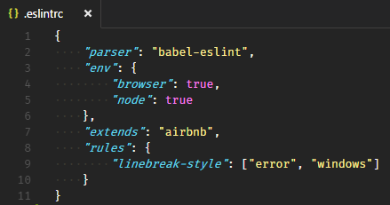
Configuration
modify package.json
add .eslintrc file
npm run lint
Notes:
That new "lint" command, eslint src, tells ESLint to read our src directory, which is all we need.
In the .eslintrc file
parser: By default, ESLint uses Espree as its parser. We override the configuration by specify babel-eslint which we have installed previously.
env: An environment defines global variables that are predefined. There are many environments available; like commonjs, mocha, jquery, etc. For this sample, we use browser and node.
extends: means we will use an existing set of Airbnb rules then customize from there. Why Airbnb? It states that A mostly reasonable approach to JavaScript. Their linting rules are popular because they are simple, sensible, and beautifully consistent.
rules: the name linebreak-style is the name of rule in ESLint. The first value is the error level of the rule and can be one of these values:
"off" or 0 - turn the rule off
"warn" or 1 - turn the rule on as a warning (doesn’t affect exit code)
"error" or 2 - turn the rule on as an error (exit code will be 1)
Last, ensure ESLint is configured properly by running npm run lint.
Reference:
http://eslint.org/docs/user-guide/configuring

Slide 19

{}
Notes:
Open VS Code
Open hackingwithreact project
Open terminal Ctrl + `
npm run lint
loading ...
As we can see, there are two warnings. Unexpected console statement. It’s common to use console.log in development only, and remove that when we deploy to production.
To see how strict the Airbnb rules,
Open Git Extensions
Checkout “Linting React using ESLint and Babel” (revision 73e4821c9a)
In this revision only has 1 rule: Strings must use single quote
Now we are going to use Airbnb rules
"extends": "airbnb",
npm install --save-dev eslint-config-airbnb eslint eslint-plugin-jsx-a11y@^2.2.3 eslint-plugin-import eslint-plugin-react
npm run lint
You got a lot of problems there!

Slide 20

Some Rules ...
Expected linebreaks to be 'LF' but found 'CRLF'
JSX not allowed in files with extension '.js'
{var} is defined but never used
Component should be written as a pure function
http://eslint.org/docs/rules/
Notes:
Expected linebreaks to be 'LF' but found 'CRLF' http://eslint.org/docs/rules/linebreak-style
The linebreaks (new lines) used in windows operating system are usually carriage returns (CR) followed by a line feed (LF) making it a carriage return line feed(CRLF) whereas Linux and Unix use a simple line feed (LF).
Add "linebreak-style": ["error", "windows"]
JSX not allowed in files with extension '.js' https://github.com/yannickcr/eslint-plugin-react/blob/master/docs/rules/jsx-filename-extension.md
For now, I don't care about restricting the file extensions that may contain JSX.
Add "react/jsx-filename-extension": [1, { "extensions": [".js", ".jsx"] }]
no-unused-vars http://eslint.org/docs/rules/no-unused-vars
Such variables take up space in the code and can lead to confusion by readers.
Remove Route, IndexRoute from Import
App.js
Component should be written as a pure function
https://github.com/yannickcr/eslint-plugin-react/blob/master/docs/rules/prefer-stateless-function.md
It’s the most interesting rather than warnings we’ve solved previously. Since React .14, it introduced a simpler way to define components called stateless functional components.
Stateless functional components are useful for presentational components. Presentational components focus on the UI rather than behavior, so it’s important to avoid using state in presentational components. Instead, state should be managed by higher-level “container” components, or via Flux/Redux/etc.
Let’s change the code to:
function App(props) {
return (
<div>
<h1>Unofficial GitHub Browser v0.1</h1>
{props.children}
</div>
);
}
Benefit:
No this Keyword, given how confusing JavaScript’s this keyword is to many developers if the code becomes more complex
Easy to Test, since it’s a pure function, your assertions are very straightforward: Given these values for props, I expect it to return this markup.
Performance, Finally, stateless functional components will soon offer improved performance as well. Since there’s no state or lifecycle methods to worry about, the React team plans to avoid unnecessary checks and memory allocations in future releases.
Reference: https://medium.com/@housecor/react-stateless-functional-components-nine-wins-you-might-have-overlooked-997b0d933dbc

Slide 21

Tips
VS Code ESLint extension
Integrates ESLint into VS Code.
ESLint Ignore File
Add .eslintignore
Notes:
Open VS Code – Extensions
Search for “ESLint” – Install
I have installed it previously, I just need to Enable it
Don’t forget to Reload – Ok
Open App.js
Notice the Red Underlines in the code
Hover it to see what the error is about
Sometimes you want it to completely ignore a whole file. For example, files under __tests__ or config file.
touch .eslintignore
Ctrl + P, eslintignore
Add following lines
/__tests__/
webpack.config.js
Ctrl + Shift + P, Reload Window

Slide 22
Hacking with React
SuperAgent
React Router
Jest
ESLint
Notes:
Finally, we are done with our agenda. (clap)

